Slide 1

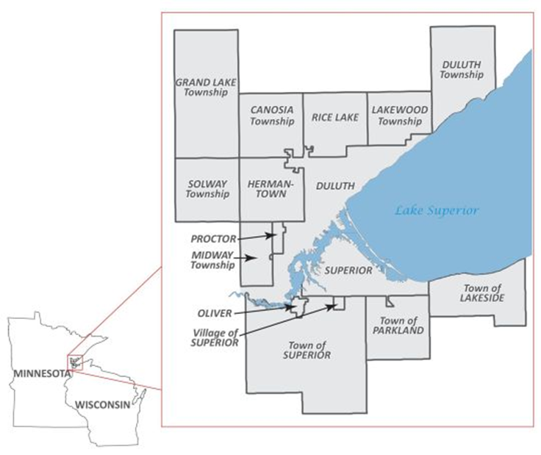
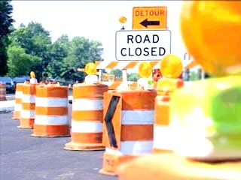
FY 2029 Proposed Projects
for the
2026-2029
Duluth Area TIP
MIC Planning Area
MIC Policy Board
February 19, 2025
Mike Wenholz

Slide 2
2026-2029 Duluth Area TIP
(under development)
2025-2028 Duluth Area Transportation Improvement Program
Current, approved TIP
Includes all federally-funded, regionally-significant transportation projects for FY 2025-2029
Projects may be amended and/or administratively modified
2026-2029 Duluth Area Transportation Improvement Program
Next year’s TIP – 2025 projects drop out, 2029 projects added
Now determining the new projects to be funded in 2029

Slide 3
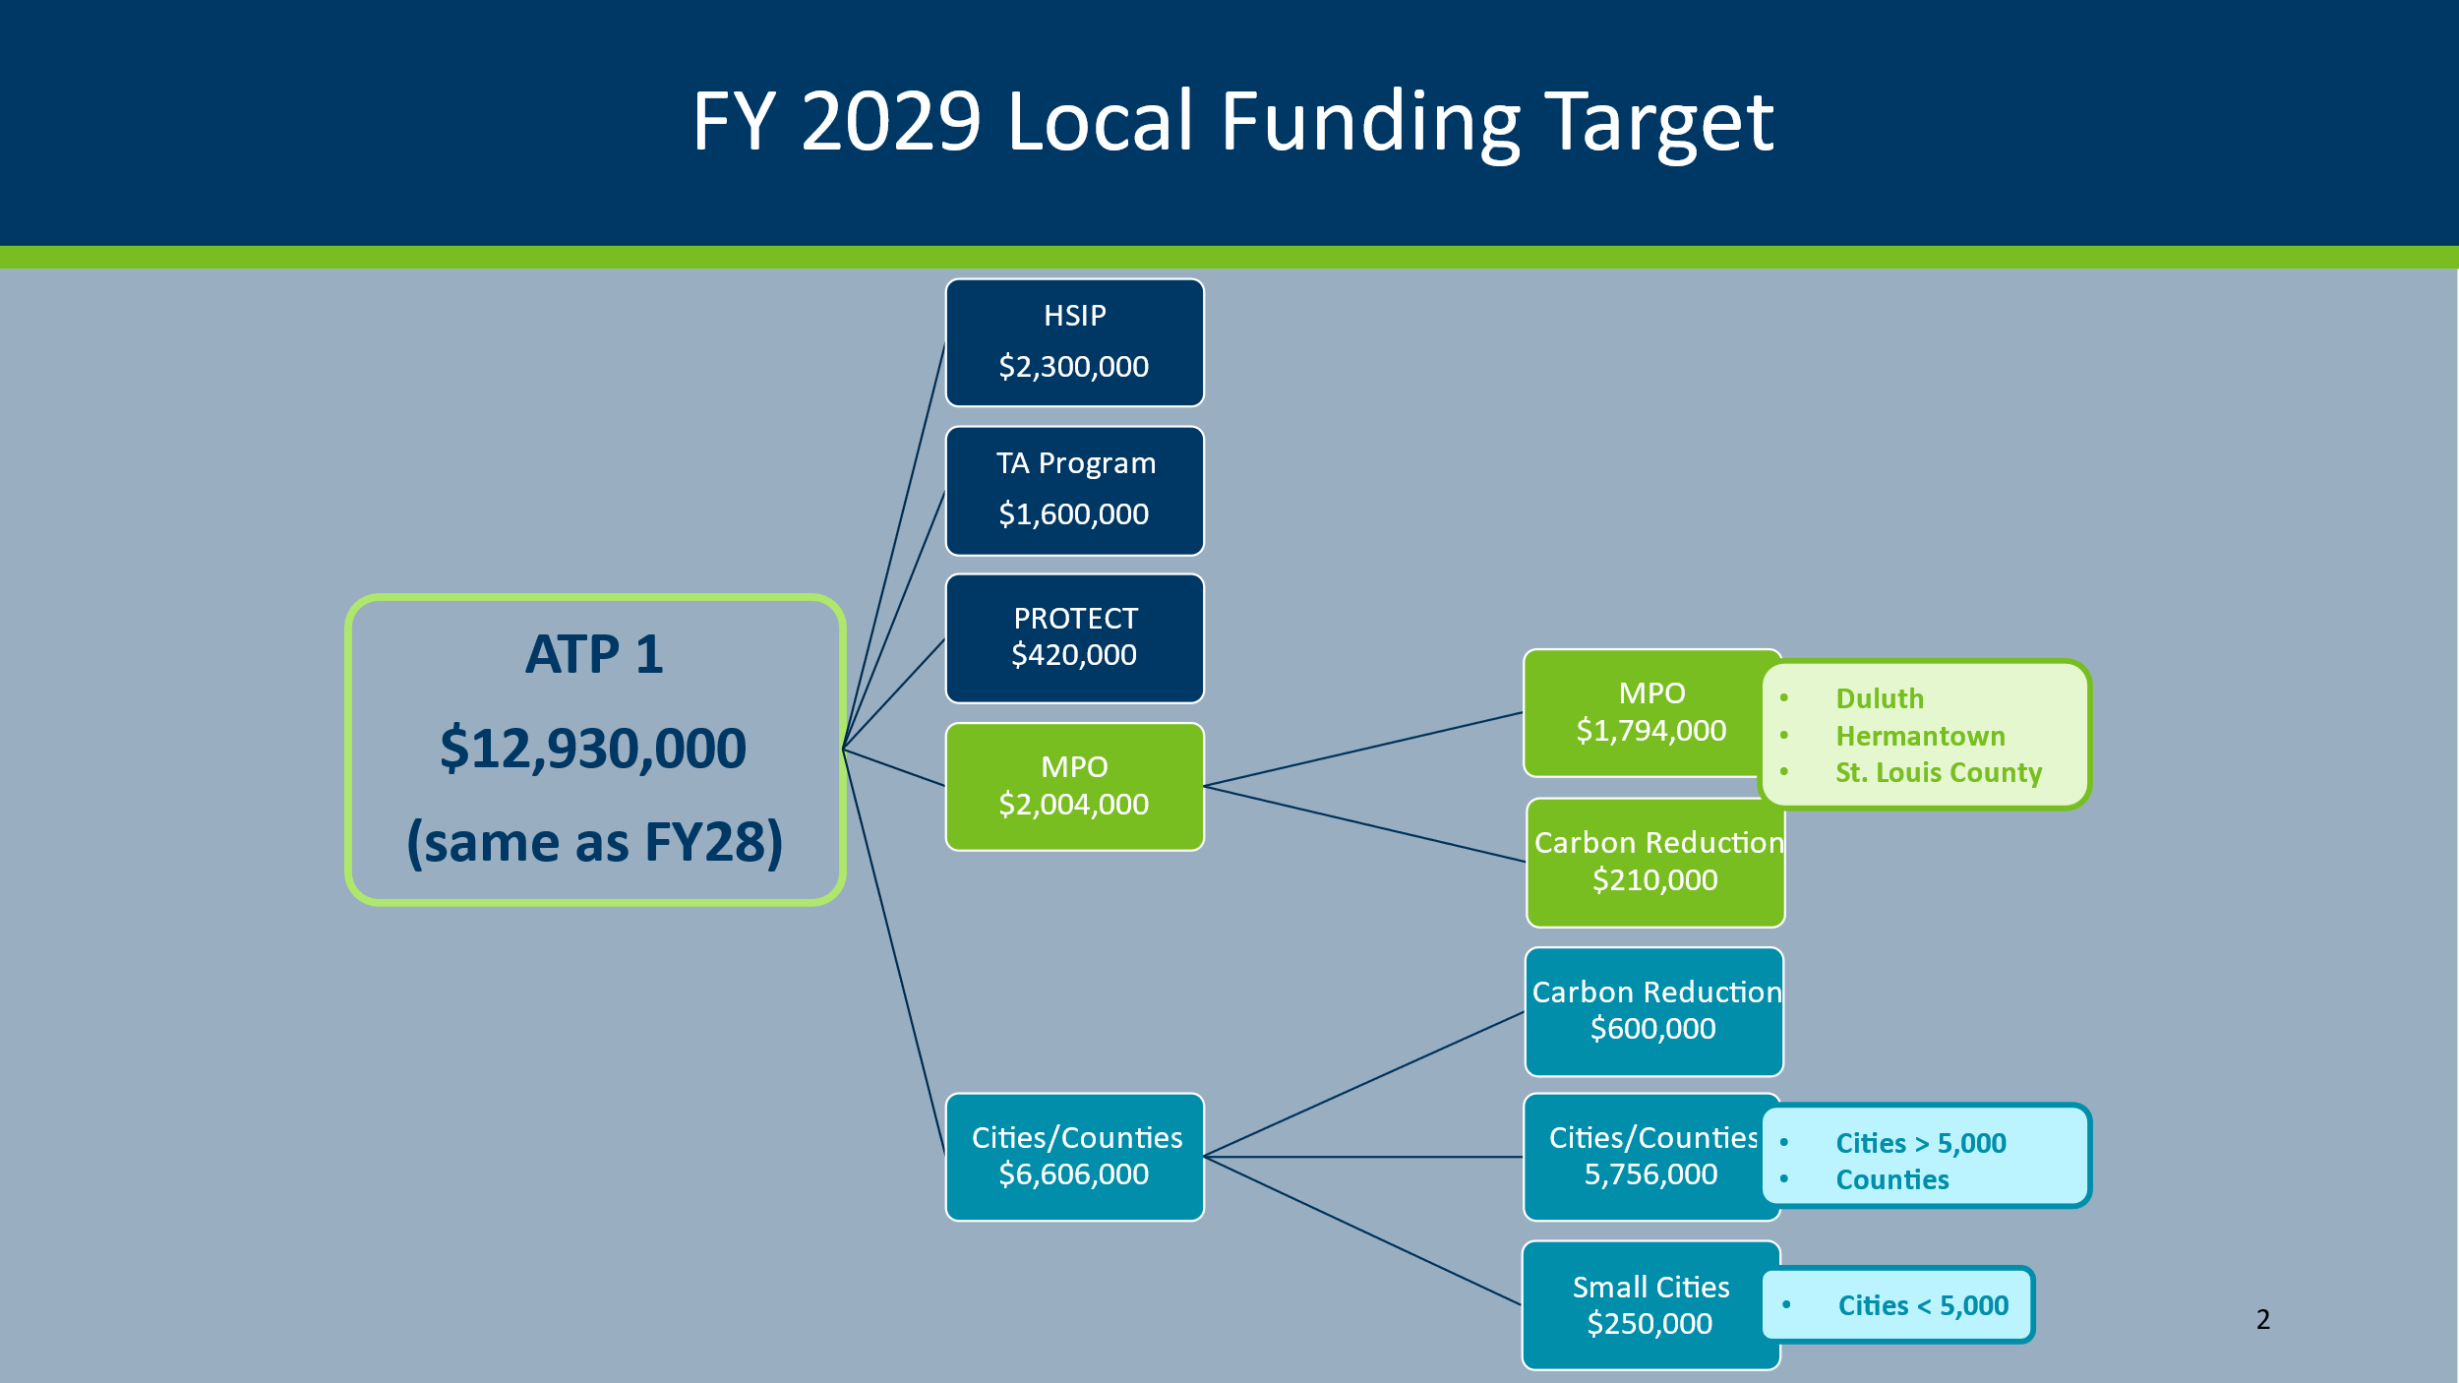
Surface Transportation Block Grants Program
(STBGP) Funds for 2029

Slide 4

Surface Transportation Block Grants Program
(STBGP) Funds for 2029
One (of several) funding sources included in the TIP
Administered via the 8-county NE MN Area Transportation Program (ATP) in coordination with MnDOT District 1 and the MIC
$7,800,000 STBGP funds allocated for 2029 projects
in the NE MN ATP area
23% ($1,794,000) allocated for 2029 projects in the MIC Area

Slide 5
Surface Transportation Block Grants Program
(STBGP) Application Process for 2029
MIC staff conducts the application process for MIC-area projects proposed to receive STBPG funds for the upcoming year.
Revised 2029 application required more detail regarding:
  Is the proposed project included in the MTP?
  What Goals and Objectives from the 2050 MTP
  will the proposed project help to accomplish?
  What federal and state Performance Measures
  will the proposed project help to accomplish?
  Provide Visualizations (maps, images, renderings, etc.)
MIC Policy Board reviews and approves the proposed projects for inclusion in the Draft 2026-2029 Duluth Area TIP

Slide 6
2029 MIC Area STBGP Project Applications
Projects proposed to receive STBGP funding in the
2026-2029 Duluth Area TIP
Jurisdiction | Project Name | Project Length (miles) | Federal (STBGP) $ | State $ | Local $ | Total $
St Louis County | Howard Gnesen Road Rehabilitation | 8 | $897,000 | $2,303,000 |  | $3,200,000
Duluth | 4th Street Reconstruction | 0.93 | $897,000 |  | $2,823,000 | $3,720,000
TOTAL |  | 8.93 | $1,794,000 | $2,303,000 | $2,823,000 | $6,920,000

Slide 7
FY 2029 – Proposed Project (1):
Howard Gnesen Road Rehabilitation
Lead Agency or Jurisdiction: St Louis County
Location: Howard Gnesen Road from Martin Rd to Normanna Rd
Length: 8 miles
Estimated Total Project Cost: $3,200,000
Amount of STBGP Funding Requested: $ 897,000
Local/Other Funding Amount: $2,303,000
Description: Full depth reclamation and bituminous paving with gravel shoulders.
Summary of Purpose or Need: Given this segment is at the end of its serviceable life, this is the appropriate treatment to rehabilitate the roadway.

Slide 8
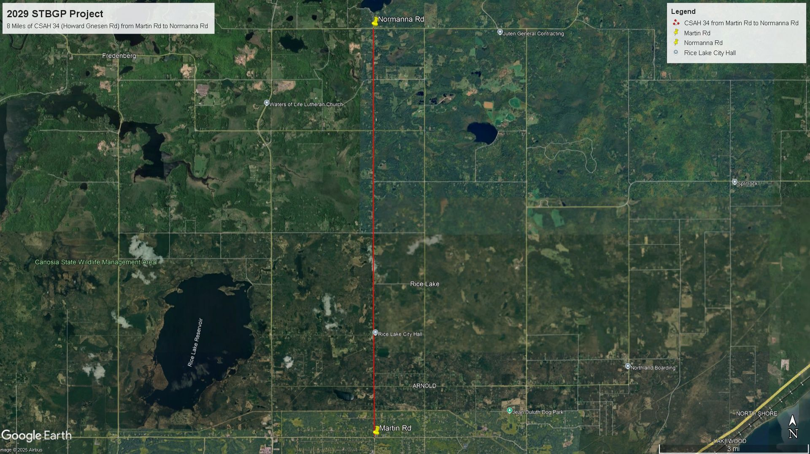
FY 2029 – Proposed Project (1):
Howard Gnesen Road Rehabilitation

Slide 9
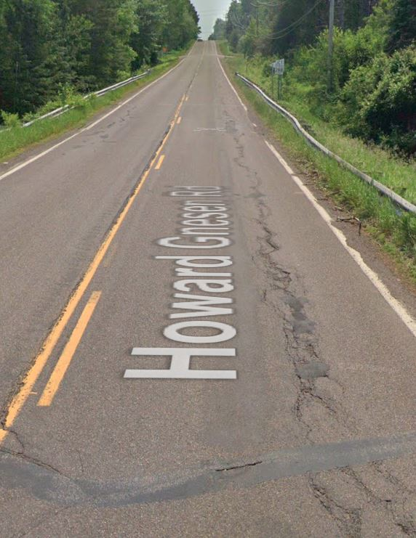

Slide 10
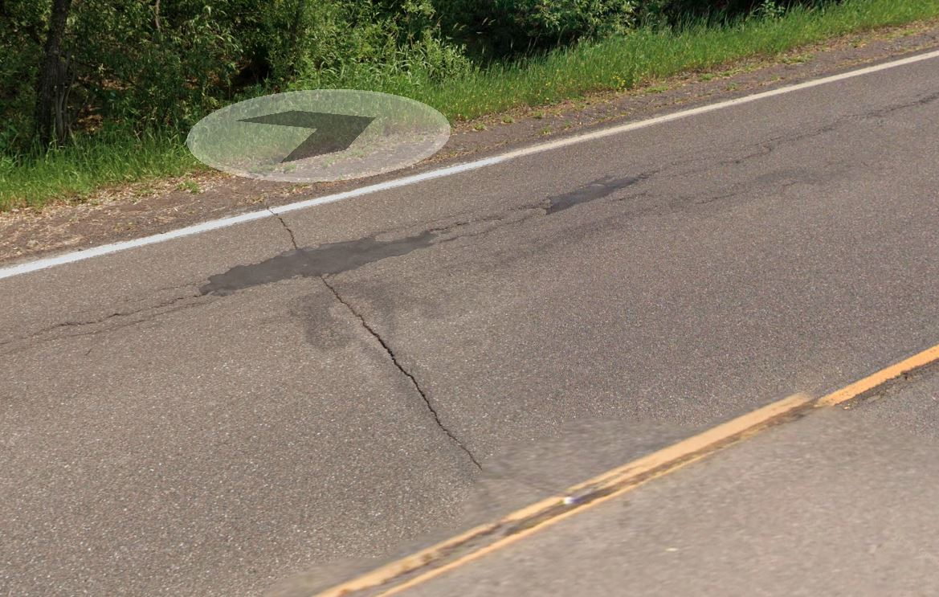

Slide 11
FY 2029 – Proposed Project (1):
Howard Gnesen Road Rehabilitation
Application Review – Is the proposed project:
Included in the Sustainable Choices 2050 project list? No.
However, “its critical needs & issues align closely with the other roads in the plan” and by the MIC’s definition of “regionally significant,” this project does not need to be included in the MTP project list.
Consistent with the Goals and Objectives of Sustainable Choices 2050? The project will help meet 13 of the 26 Objectives of Sustainable Choices 2050, including at least 1 objective under all 5 goals.
Consistent with the MIC’s adopted Performance Measures 1, 2, and/or 3? The project will help make progress in meeting all 5 of the PM1 Safety targets in Sustainable Choices 2050 by improving pavement condition, as potholes, cracks, bumps, and other rough surfaces that currently exist contribute to vehicles losing control and leaving the roadway.
Notes:
Based on St. Louis County’s application the proposed project is…

Slide 12
FY 2029 – Proposed Project (1):
Howard Gnesen Road Rehabilitation
Application Review – How will the proposed project help to implement the Vision of Sustainable Choices 2050?
The project will include improvements for automobiles and vehicular freight transportation.
The corridor will be safer and minimize or mitigate risk for both people and freight as smooth, well-maintained roads reduce the likelihood of vehicles losing control, improve conditions for emergency response, and are more resilient to environmental stressors such as heavy rains, floods, and freezing conditions.
This corridor is a key road to connect people with key community resources as both the Rice Lake City Hall and Gnesen Community Center are on or adjacent to this segment.
Notes:
Based on St. Louis County’s application the proposed project will help bring the vision of Sustainable Choices 2050 to life because it will…

Slide 13
FY 2029 – Proposed Project (1):
Howard Gnesen Road Rehabilitation
The project would help to improve the health of people and the environment as smooth pavement reduces driver discomfort and musculoskeletal issues and reduces fuel consumption of vehicles.
The project is important to local economic vitality as this corridor is a major collector that connects people with numerous popular lakes and reservoirs north of Duluth and is a route used by many rural residents to travel to the Duluth area for work, commerce, and recreation.
In addition, this corridor is an alternate freight route in and out of Duluth to the Iron Range and to support the local businesses in the rural areas north of Duluth.
The project would also include road shoulder improvements.

Slide 14
FY 2029 – Proposed Project (1):
Howard Gnesen Road Rehabilitation
Comments or questions
about this project?

Slide 15
FY 2029 – Proposed Project (2):
4th Street Reconstruction
Lead Agency or Jurisdiction: City of Duluth
Location: 4th Street from Mesaba Ave to 6th Ave East
Length: 0.93 miles
Estimated Total Project Cost: $3,720,000
Amount of STBGP Funding Requested: $ 897,000
Local/Other Funding Amount: $2,823,000
Project Description: Full reconstruction, including water main replacement and safety, intersection and multimodal improvements.
Summary of Purpose or Need: This segment was last reconstructed in 1976 and water mains under the roadway are due for replacement. It is also necessary to reconstruct the roadway to improve safety for all users of the City’s multi-modal network.

Slide 16
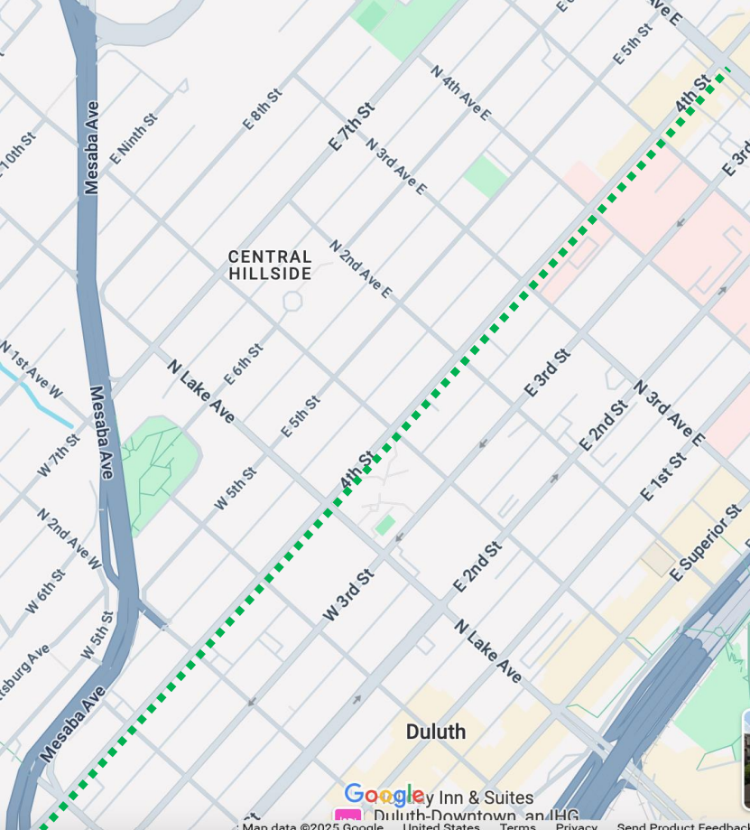

FY 2029 – Proposed Project (2):
4th Street Reconstruction
6th Avenue East
Mesaba Avenue

Slide 17
FY 2029 – Proposed Project (2):
4th Street Reconstruction
Application Review – Is the proposed project:
Included in the Sustainable Choices 2050 project list? Yes
(# MN-03-28); This project is listed as a Priority Project
Consistent with the Goals and Objectives of Sustainable Choices 2050? The project will help meet 12 of the 26 objectives, including at least 2 objectives under all 5 goals.
Consistent with the MIC’s adopted Performance Measures 1, 2, and/or 3? The project will help make progress in meeting all 5 of the PM1 Safety targets, including traffic calming measures consistent with the Safe Streets for All Safety Action Plan.

Slide 18
FY 2029 – Proposed Project (2):
4th Street Reconstruction
Application Review – How will the proposed project help to implement the Vision of Sustainable Choices 2050?
The project will include a variety of multimodal enhancements, including walking, bicycling, and transit-related improvements.
The corridor will be safer to walk along and across by including sidewalk, intersection, and lighting improvements.
The proposed improvements to this corridor would enhance community connectivity to critical neighborhood destinations, especially for this neighborhood with identified equity needs.
The project would encourage individuals to engage in active transportation (such as walking and bicycling), leading to greater physical and mental health benefits and reducing single person vehicle miles travelled, minimizing negative environmental impacts.

Slide 19
FY 2029 – Proposed Project (2):
4th Street Reconstruction
The project would maintain and improve a key corridor to the broader East-West movement of people across Duluth’s Hillside, including a bus line.
The project would improve the primary street identified in Essentia Health’s land use study, which aims to revitalize the Hillside neighborhood.
The project would also include stormwater management improvements.

Slide 20
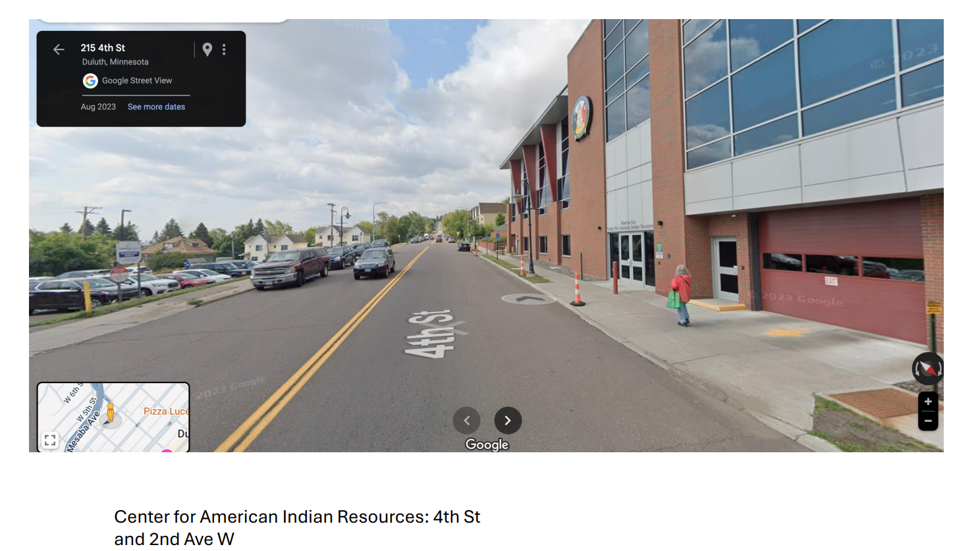
FY 2029 – Proposed Project (2):
4th Street Reconstruction

Slide 21
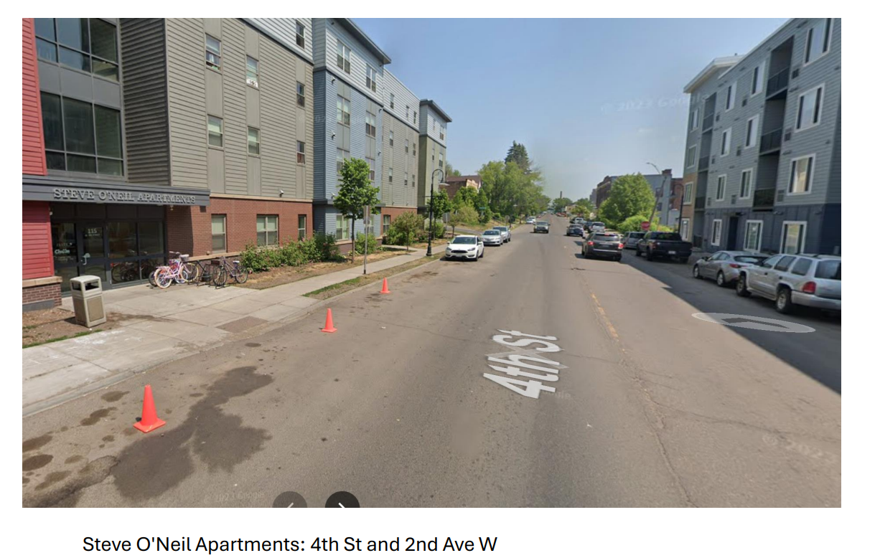
FY 2029 – Proposed Project (2):
4th Street Reconstruction

Slide 22
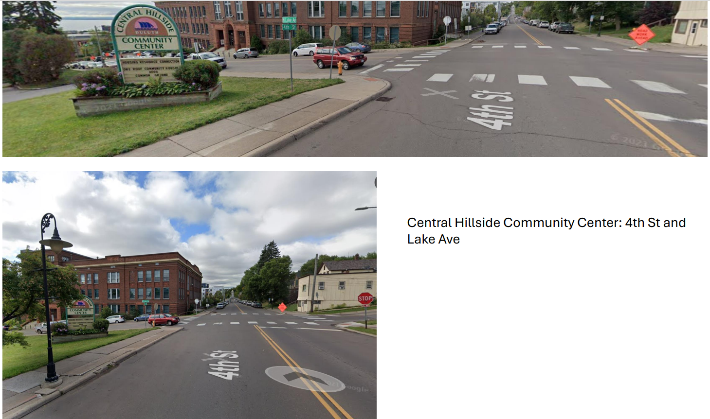
FY 2029 – Proposed Project (2):
4th Street Reconstruction

Slide 23
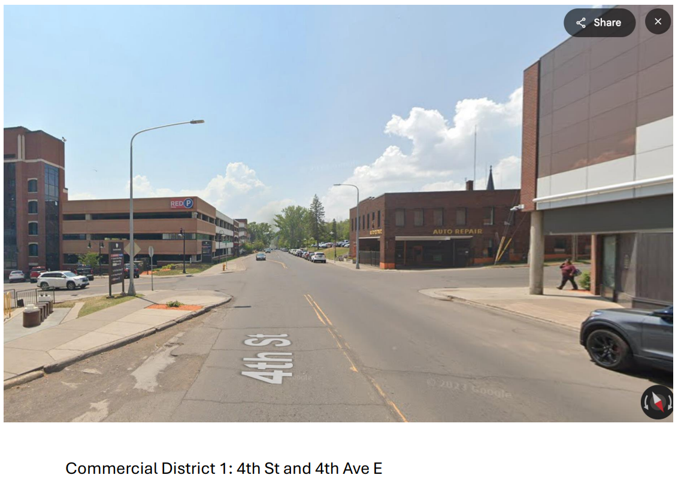
FY 2029 – Proposed Project (2):
4th Street Reconstruction

Slide 24
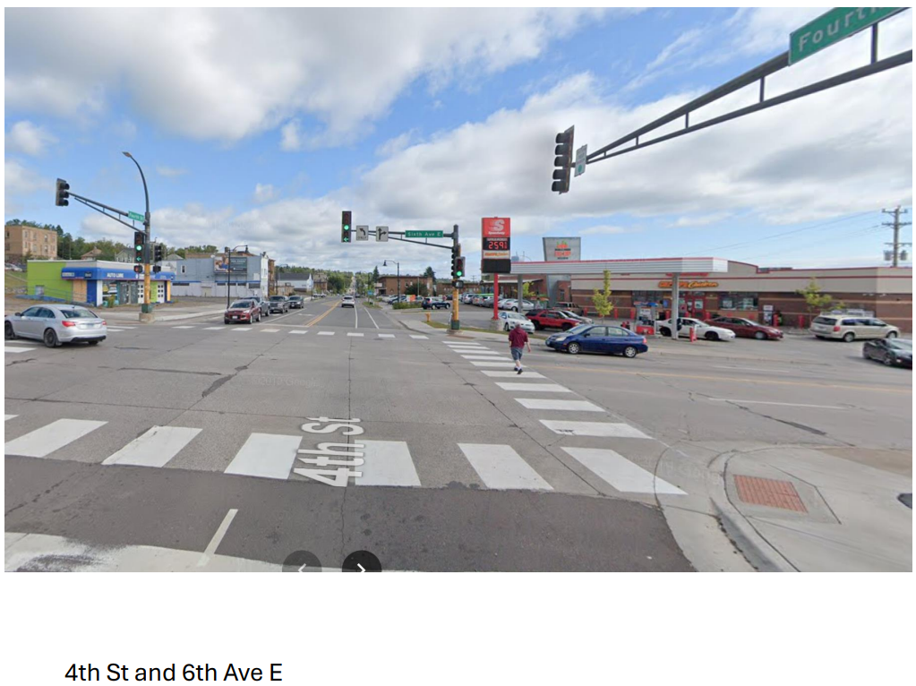
FY 2029 – Proposed Project (2):
4th Street Reconstruction

Slide 25
FY 2029 – Proposed Project (2):
4th Street Reconstruction
Comments or questions
about this project?

Slide 26
MOTION REQUESTED
Approve proposed FY2029 STBGP*-funded projects
for inclusion in the
Draft 2026-2029 Duluth Area TIP
*Surface Transportation Block Grant Program
Jurisdiction | Project Name | Project Length (miles) | Federal (STBGP) $ | State $ | Local $ | Total $
St Louis County | Howard Gnesen Road Rehabilitation | 8 | $897,000 | $2,303,000 |  | $3,200,000
Duluth | 4th Street Reconstruction | 0.93 | $897,000 |  | $2,823,000 | $3,720,000
TOTAL |  | 8.93 | $1,794,000 | $2,303,000 | $2,823,000 | $6,920,000

Slide 27
OPPORTUNITY FOR PUBLIC COMMENT
Name and affiliation (if any)
Comment Time Limit: 3 minutes
Limit your remarks to the specific plan, study or document under consideration by the Board

Slide 28
FY 2029 Proposed Projects
for the
2026-2029
Duluth Area TIP
Thank You!
MIC Policy Board
February 19, 2025

Slide 30
Surface Transportation Block Grants Program
(STBGP) Application Process for 2029
MIC staff conducts the application process for MIC-area projects:
    November 2024: Pre-application meeting
Revised 2029 application required more detail regarding:
  Is the proposed project included in the 2050 MTP?
  What Goals and Objectives from the 2050 MTP will the proposed project help to accomplish?
  What federal and state Performance Measures will the proposed project help to accomplish?
  Project visualizations (map and photos)
  Plain language project descriptions
  Connections to other planning initiatives (State/Local/MIC)
December 2024: Application distributed to eligible jurisdictions

Slide 31
Surface Transportation Block Grants Program
(STBGP) Application Process for 2029
Application process for MIC-area projects (continued):
    January 2025: Applications Due: clarifications or additions
    to applications may be requested by MIC staff; summary of proposed project evaluation is prepared for TAC and MIC
    February 2025: Proposed projects presented to the MIC Board for
    review and approval to include in the Draft 2026-2029 Duluth Area TIP
    March 2025: The MIC’s STBGP projects are forwarded to the NE MN ATP
    July 2025: Draft Duluth TIP released for 30-day public comment period
    August 2025: Final Duluth TIP presented to MIC Policy Board for Adoption
    November 2025: Final approvals of Duluth TIP by MnDOT, FHWA, FTA

